Slide 1


Wearable continuous glucose monitoring
HRfH Connect 7th February 2025
Sophie Eastwood & Michele Orini

Slide 2
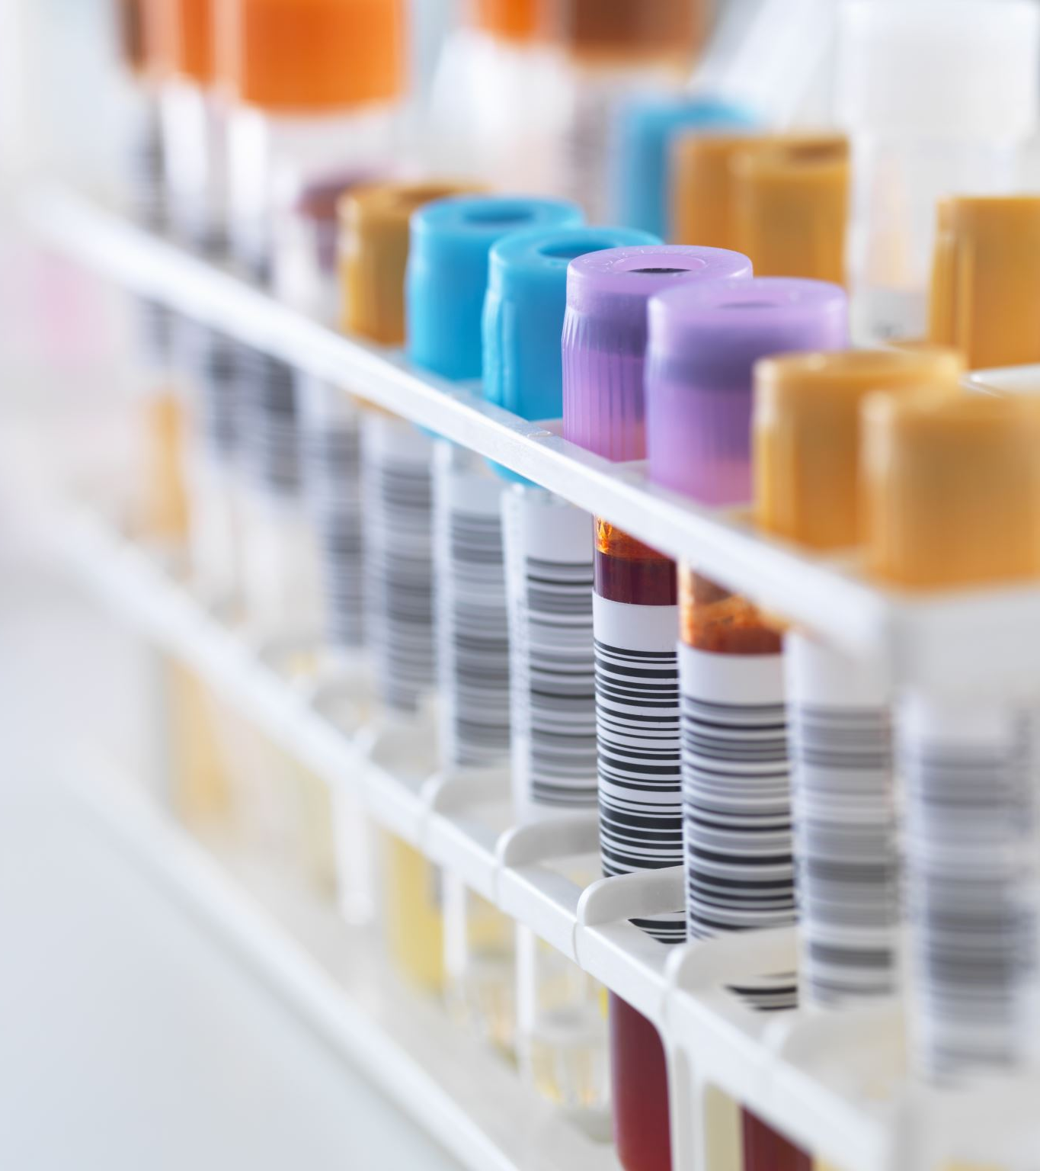
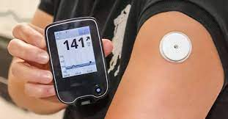
Glucose variability is important
vs.

Slide 3
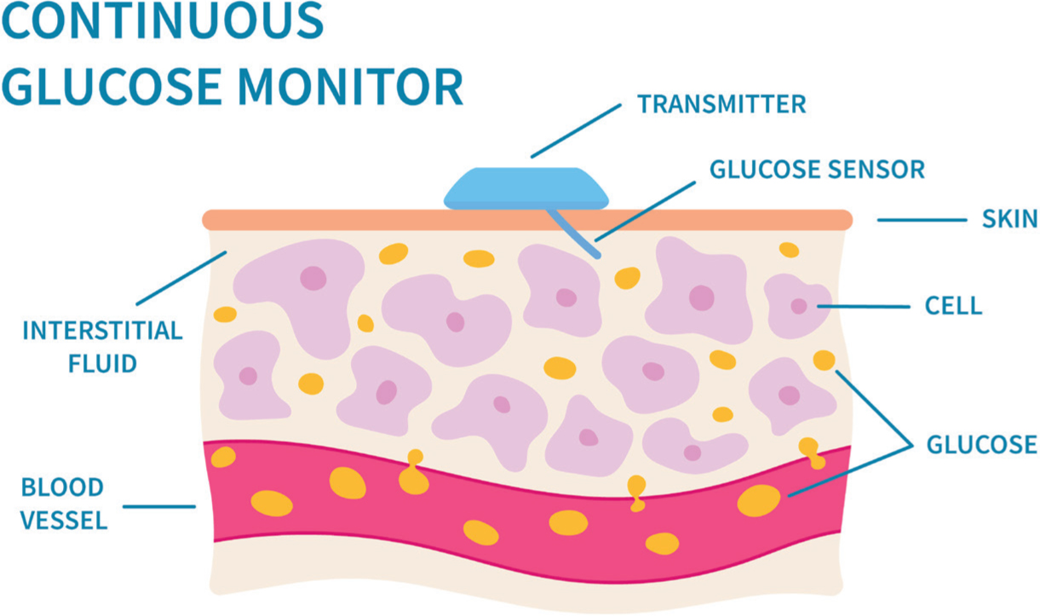

Data collection
326 participants
Aged 75-77
7 days CGM, every 15 mins
https://www.practicenursing.com/content/clinical-focus/continuous-glucose-monitoring-for-type-1-diabetes/

Slide 4
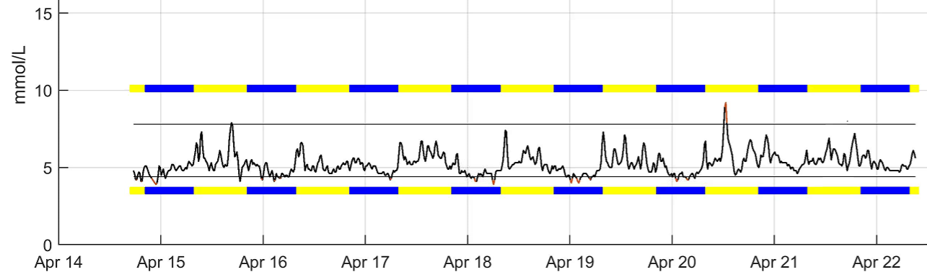
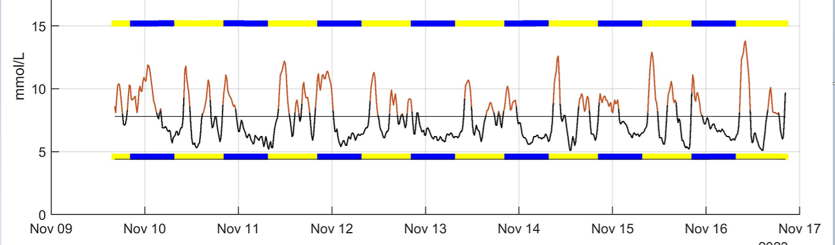
Two participants with normal mean glucose
HbA1c
5.7 %
HbA1c
5.9 %

Slide 5
Unexpected levels of time above range

Slide 6
Summary
n
  Acceptable & feasible
n
  Potential for risk prediction
n
  Enables study of disease mechanisms

Slide 7
Acknowledgements
Nish Chaturvedi
Jonathan Schott
Joshua King-Robson
Andy Wong
Scott Chiesa
Heidi Murray-Smith
Lee Hamill Howes
The Insight46 team
Insight46 participants

